Slide 1
Made in Wakefield: the MCP model, general practice development and the collaborative future of health and care
Martin Smith Head of Connecting Care Commissioning
Greg Connor GP and CCG Medical Advisor

Slide 2

The journey to system integration
April 2014 – first Connecting Care Hub opens at Bullenshaw supported by Provider Alliance
April 2014 - West Wakefield wins Prime Minister’s Challenge Fund (PMCF) bid
October 2014 – NHS Five Year Forward View Published
January 2015 – Wakefield Connecting Care awarded Pioneer status
Autumn 2015 – West Wakefield awarded a Multispecialty Community Provider (MCP) Vanguard and Wakefield Provider Alliance awarded a Care Home Vanguard.
July 2016 – MCP Framework published by NHS England
April 2017 – MCP moves from West Wakefield to Wakefield CCG and Care Homes Vanguard becomes part of the MCP
August 2017 – General practice signs up to MCP Alliance Agreement

Slide 3







NHS Five Year Forward View introduces Vanguards – October 2014
Published in October 2014
A shared vision across seven national bodies
New care models programme key to delivery
Focuses on both NHS and care services

Slide 4
Five new care models announced –
Wakefield has 3/5
Multispecialty community providers
moving specialist care out of hospitals into the community
Acute care collaboration
local hospitals working together to enhance clinical and financial viability
Enhanced health in care homes
offering older people better, joined up health, care and rehabilitation services
Integrated primary and acute care systems
joining up GP, hospital, community and mental health services
Urgent and emergency care
new approaches to improve the coordination of services and reduce pressure on A&E departments

Slide 5

MCP emerging care model and contract framework published - July 2016
The building blocks of an MCP are the ‘care hubs’ of integrated teams. Each typically serves a community of around 30-50,000 people.
Three forms of MCP:
Virtual – Alliance Agreement;
Partial (excludes primary medical services); and
Fully Integrated (Includes primary medical services).
Prospective bidders to engage with GPs and vice-versa. All prospective provider would be asked to demonstrate that they could command the support of the local GPs for the model.

Slide 6
MCP emerging care model and contract framework published - July 2016
“An MCP is about integration. As a patient or a clinician, you would not choose to recreate from scratch the historical partitions between primary, community, mental health and social care and acute services. The boundaries make it harder to provide joined-up care that is preventative, high quality and efficient. The MCP model dissolves the divides. It involves redesigning care around the health of the population, irrespective of existing institutional arrangements. It is about creating a new system of care delivery that is backed up by a new financial and business model.”

Slide 7
The MCP Development Phases
Phase One – (Autumn 2015 to Spring 2017) – West Wakefield trial the MCP model across 1/3 of Wakefield and Care Home Vanguard rolled out to 15 homes.
Phase Two (Spring 2017 to Autumn 2018) – Virtual MCP starts supported by Alliance Agreement signed August 17. This is an 18 month agreement signed by all partners and GP Federations. Care Home Vanguard expanded to 22 homes and involves all GP Practices.
Phase Three – External Vanguard resources finish April 2018. Focused on model sustainability and evaluation.

Slide 8
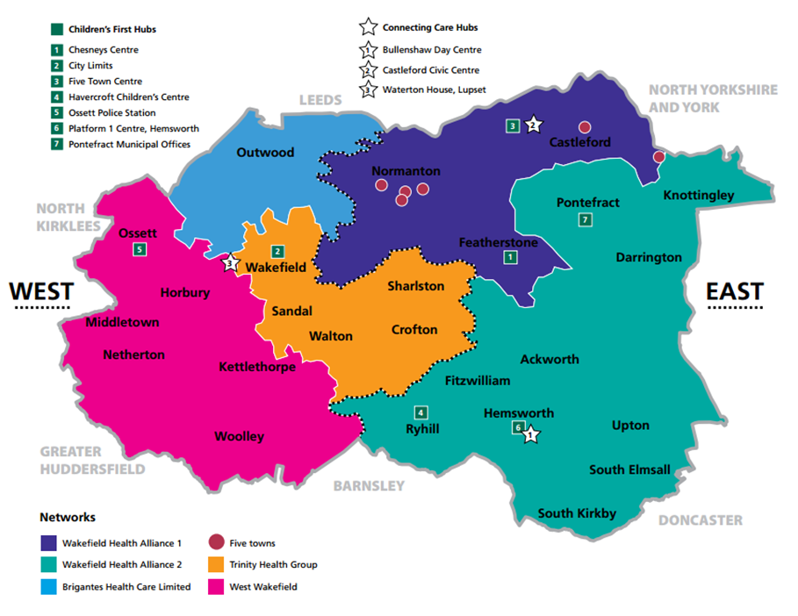
The Development of General Practice
in Wakefield
PCGs
PCTs
PCT
CCG
Networks
Federations
Confederation

Slide 9
People-centred primary care (WHO 2008)…
Evidence-based orientation to health and care system
Health improvement even when resources constrained
Generalist healthcare is a key pillar
Staying healthy
General Practice
Specialist health care
Urgent and emergency health care
Community health and social care

Slide 10
… in an accountable care system
1 Improved population health
2 Better patient experience of care
3 Increased efficiency
4 Enhanced staff morale and wellbeing

Slide 11
General practice development: practice, sector and system
System
Conexus
Accountable care
Sector
Federations
Practice
Core team
Registered list
Primary Care Homes

Slide 12
Prioritising interventions
Improved patient care
Benefits to health and care system
Increased general practice resilience

Slide 13
GPFV nine transformation projects
Rationale | Projects
Avoid extinction event, raise quality and morale | 1 Wakefield General Practice Workforce Development Academy
Expand team to give GPs time to care, care navigation to first contact, use budgets efficiently, reduce medicalisation | 2 Clinical pharmacists 3 Physio First 4 Psychological therapy for LTCs and medically unexplained symptoms
Improve continuity of care, work in one team, reduce dumping of work, use budgets efficiently | 5 Integrated nursing teams 6 Consultant attachment 7 Care home attachment
Improve responsiveness, manage urgent workload, secure £2m pa | 8 Generalist care 24/7 9 Home visiting service

Slide 14
Conexus roles
System leadership
NMOC Board
Sector Development
Workforce Academy
Practice and federation development
Primary Care Home
Service Provision
GP Care Wakefield
Connecting Care
Specialist care
Other clinical services
Virtual Practice
Quality
Transformation Projects

Slide 15
General practice and the provider system
Public health services
Community nursing
Community mental health
Connecting Care hub services
General practice
Acute Trust
Third Sector
Mental Health Trust
Social Care

Slide 16
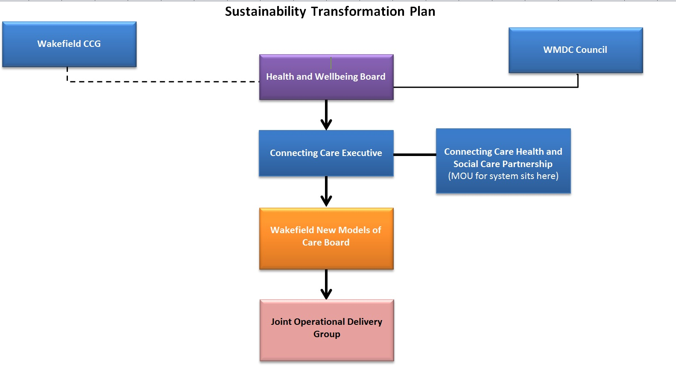
System Governance

Slide 17

What have been the challenges?
Multiple providers each operating in their own silos
  Separate teams serving the same patients
  Differing cultures / value systems
  Inclusion / exclusion criteria, referral forms
  Poor information sharing, lack of IT and IS integration
  Lack of trust and mutual understanding
  Differing contracts KPIs and targets
  Tendency to shunt problems and costs around
  Organisational hierarchies
  Focus on caseload and no situational awareness
  Struggling workforce
Lacking effective clinical leadership on the ground

Slide 18
What we learned
The source of most of the frustrations and anxiety has been different messages and language
Respect and explore sovereignty and subsidiarity – practice, group of practice, district, system
Things don’t always work out – physio first
It takes time to build relationships and trust

Slide 19
Key general practice success factors
Shared system principles
Practice and LMC engagement
Federation and Conexus leadership and development
Shared clarity, focus and prioritization aided by the burning platform of austerity
Research, evaluation, consolidation and layering
System leadership and collaboration
Visible product (eg GP Care Wakefield, Academy, clinical pharmacy, home visiting, other transformation projects)

